Slide 1
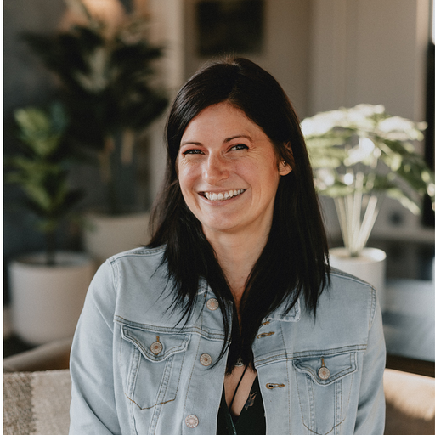
Workday Skills Integration Enablement
HEIDI LEAR
PARTNER MARKETING MANAGER
MAY 2026 | CONFIDENTIAL | GTM TEAM CALLS

Slide 2
EVENTS MARKETING · Q2 2026
11
3
9
4
Q2 EVENT LINEUP
Events
Months
Cities
Countries
Tradeshow
Exec Dinner
Matchmaking
Workshop
APRIL
MAY
JUNE
MATCHMAKING
EXEC DINNER
TRADESHOW
iVentiv Copenhagen
DFW Construction Dinner
TICE
Apr 21–22 · Copenhagen, DK
May 11 · Dallas, US
Jun 16–18 · Raleigh, NC, US
TRADESHOW
MATCHMAKING
iVentiv Texas
Docebo Inspire
May 12–13 · Dallas, US
EXEC DINNER
Apr 20–22 · Miami, US
Field Event — TBD
WORKSHOP
Jun TBD · TBD, US
Dubai Workforce Workshop
TRADESHOW
May 14 · Dubai, UAE
Learning Technologies London
Apr 29–30 · London, UK
TRADESHOW
ATD
May 17–20 · Los Angeles, US
EXEC DINNER
Learning Leaders Collective
EXEC DINNER
Apr 29 · London, UK
ATD Exec Dinner
May 19 · Los Angeles, US

